Slide 1
Chapter: 8.4
Avogadro’s hypothesis and molar volumes

Slide 2
In 1811, Amadeo Avogadro attempted to show how the volume of a gas was related to the amount of gas present.
Avogadro’s hypothesis states that equal volumes of any gas, measured at the same temperature and pressure, contain the same number of particles.

Slide 3
No matter what the gas is, the total number of particles would be the same under the same conditions. So, provided the temperature and pressure are the same, 1L of hydrogen has the same number of particles as 1L of helium.
If the number of particles were doubled, then the volume would double.

Slide 4
Molar volume
A mole is defined as a fixed number of particles
( Avogadro’s constant, 6.02X 10²³ , so it follows that equal volumes of different gases, measured at the same temperature and pressure contain the same number of moles. This is called molar volume of a gas.
At standard temperature and pressure (0⁰C and 100 kPa) the molar volume of a gas is 22.71 L.

Slide 5
At standard laboratory conditions ( 25⁰C and 100kPa) the molar volume of a gas is 24.79L.
The relationship between number of moles and volume of a gas can be expressed as:
Number of moles of gas= volume of gas at STP
volume of one mole of gas at STP
n= V/ 22.71
Where “n” is the number of moles and “V” is the volume of gas (L) at STP.

Slide 6
Check worked example in page: 356 NC

Slide 7
The general gas equation
If Boyle’s and Charles’ laws are combined with Avogadro’s hypothesis, the resulting relationship, called the general gas equation, includes all conditions as variables.
The general gas equation can be called as the ideal gas equation and the universal gas equation. It provides a relationship between pressure, volume, temperature and the amount of gas:
PV= nRT where P is pressure in kPa, V is volume in L
n is the total number of moles of gas present, R is the universal gas constant= 8.31 JK⁻¹mol⁻¹ T is temperature in K.

Slide 8
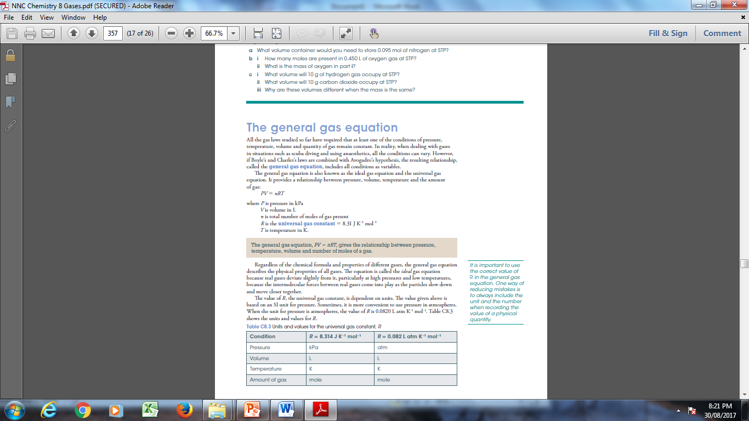

Slide 9
Regardless of the chemical formula and properties of different gases, the general gas equation describes the physical properties of all gases. The equation is called the ideal gas equation because real gases deviate slightly from it, particularly at high pressures and low temperatures, because the intermolecular forces between real gases come into play as the particles slow down and move closer together.
The value of R is dependent on units. The value given in previous slide is based on an ST unit for pressure.

Slide 10
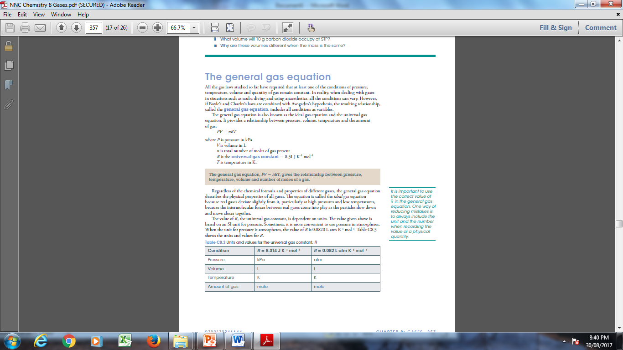

Slide 11
Check the worked example: 8.5 in NC: page: 358
Do Question set: 8.4 Page: 360 Q’s: 1,2, 4,6 and 9

